Slide 1
New York City Taxi Fare Prediction
Qixiang Zhou, Yujun Xie

Slide 2
Use Case
System run data model with training data set and match the test data set to generate the successful prediction rate.
Use Scala web develop a web page to present.

Slide 3
Methodology
Ingest data set to data model with Scala
Build data(ML) model with Spark APIs
Run the system with training data set
Input test data set and generate successful prediction rate
Build a web page, with Google Map API to present the trained model

Slide 4
Data Description
key : string (Unique)
pickup_datetime : float
pickup_longitude : float
pickup_latitude : float
dropoff_longitude : float
dropoff_latitude : float
passenger_count : integer
fare_amount : float (Target)

Slide 5
Milestones
Start project and build Git repository(week 10)
Configure working enviorment and do research about Spark APIs (week 11)
Ingest taxi fare data(week 12)
Build machine learning model(week 12)
Test data model and get result(week 13)
Build web page to present the work(week 14)

Slide 6
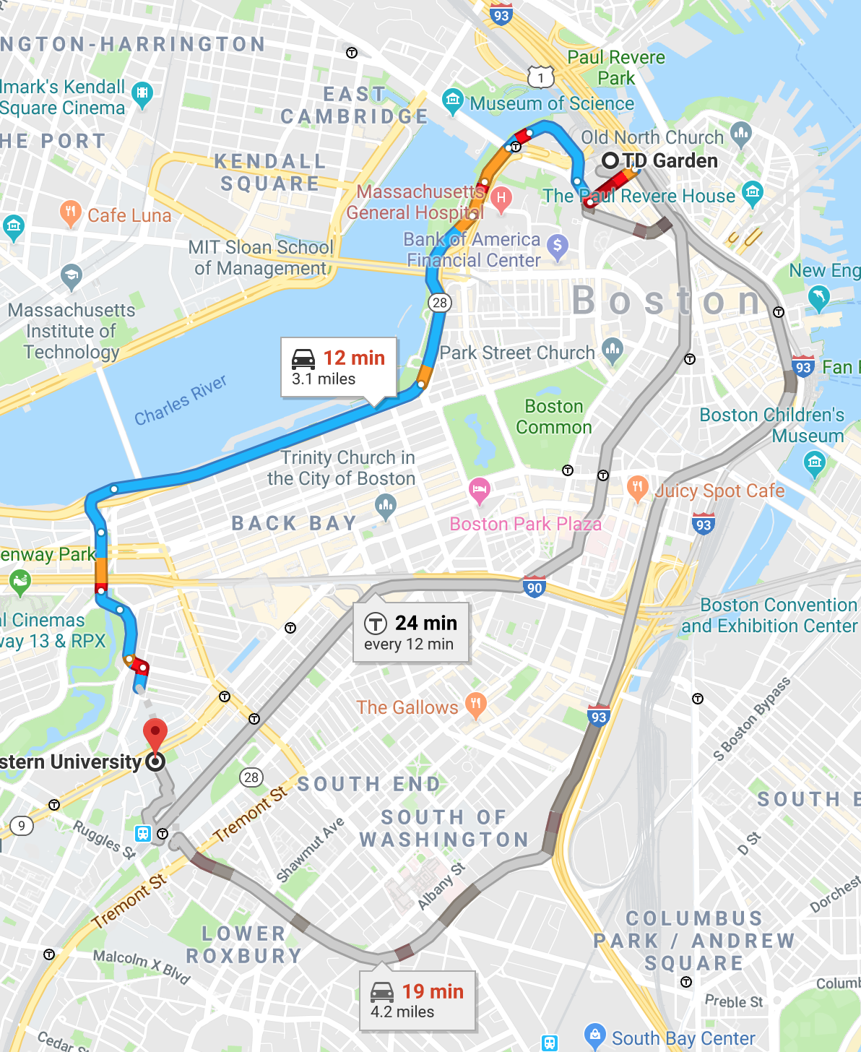
Base on:
1. trained model
2. Start point and end point
We will give taxi fare prediction

Slide 7
Repository
Github: https://github.com/JIMsZHOU/CSYE7200_FinalProject
The whole project will be majority code in Scala (based on Spark, and Play-2.0) and with some HTML, JavaScript and Java.

Slide 8
Acceptance criteria
The successful prediction rate should be larger than 75%

Slide 9
Goal
The test successful rate will be above 75%
Build a web page for the prediction result

